Slide 1
Module 5.11.2: Exception Handling

Slide 2
There 3 Types of Errors in Python
From the easiest to find, to the hardest to find:
SyntaxError – the text is not correct Python code
RuntimeError – the text is Python code, but had an error during run
Logical Error – an error in your algorithm, think again how you should solve the problem.

Slide 3
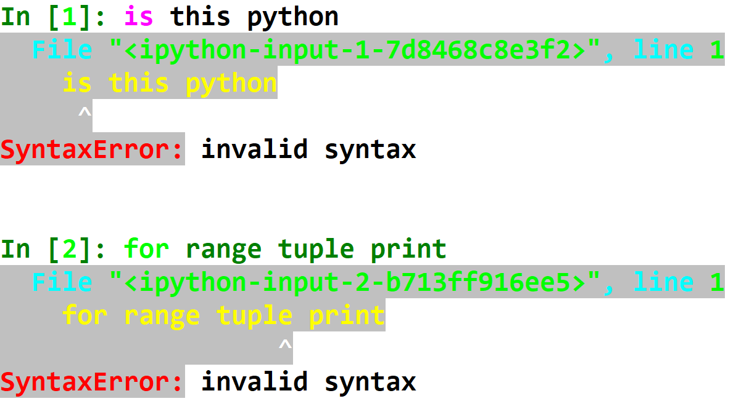
SyntaxError

Slide 4
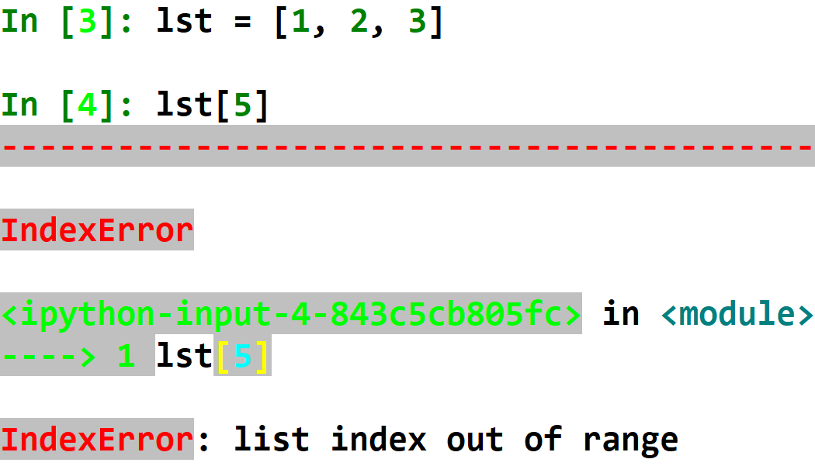
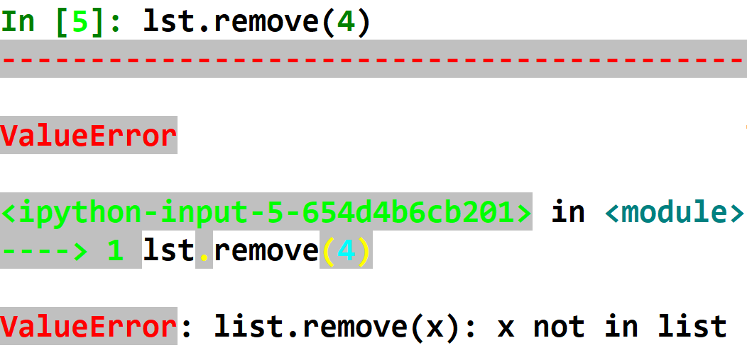
Runtime Errors
With these errors, the text is correct Python code, but an error was found during execution.

Slide 5
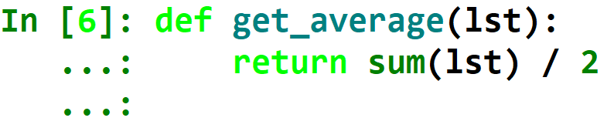
Logical Error
This is the most annoying type of error. No Exception is raised here.
It happens when your code gives you a different output than expected.
This means you have a problem in your algorithm, and you need to either rethink it, or rewrite it.
For example:

Slide 6
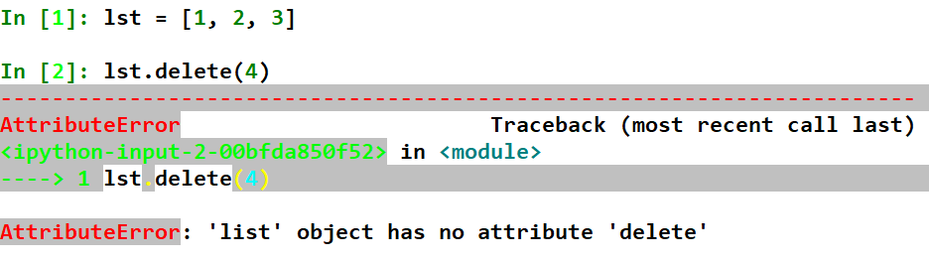
Different Parts of an Exception
Error Traceback
Error Type
Error Message

Slide 7
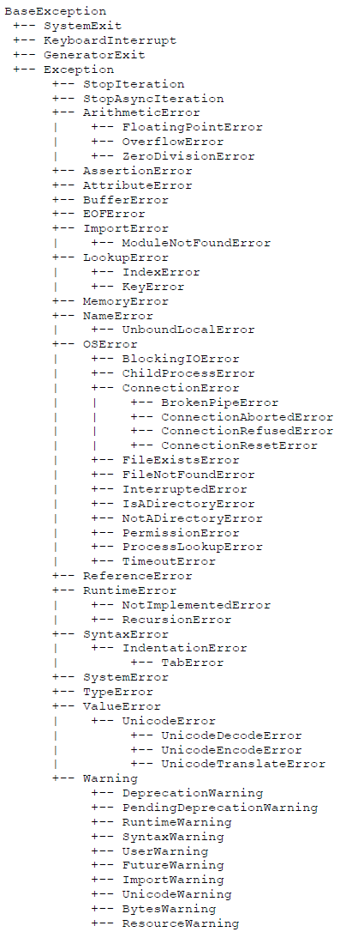
Error Type
There are many different error types in Python.
You will slowly get to know them.
They are arranged in a hierarchy (tree), with some Exceptions being a specific case of others.

Slide 8
Exceptions Hierarchy Tree

Slide 9
Error Message
This usually is text that explains why the exception was raised.
Read it!

Slide 10
Traceback

Slide 11
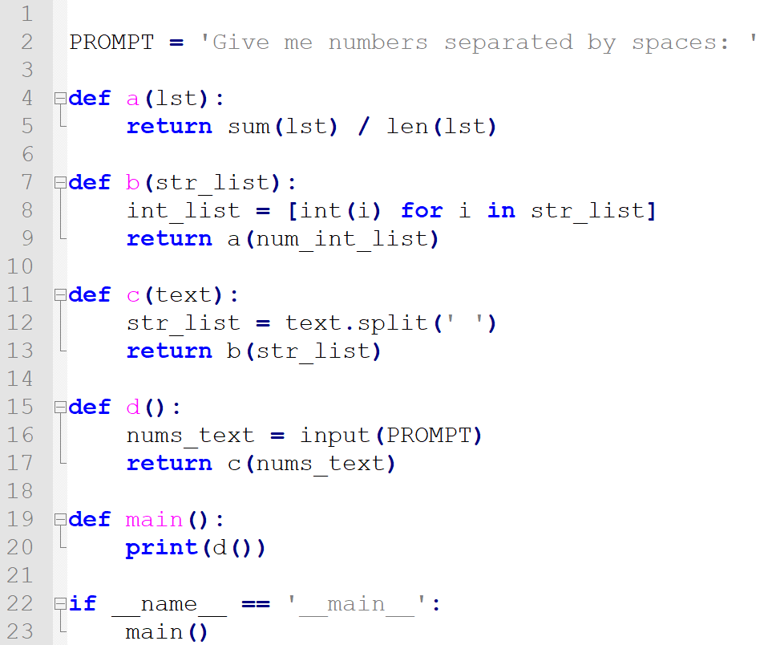
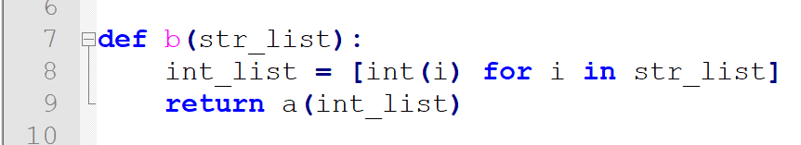


Slide 12
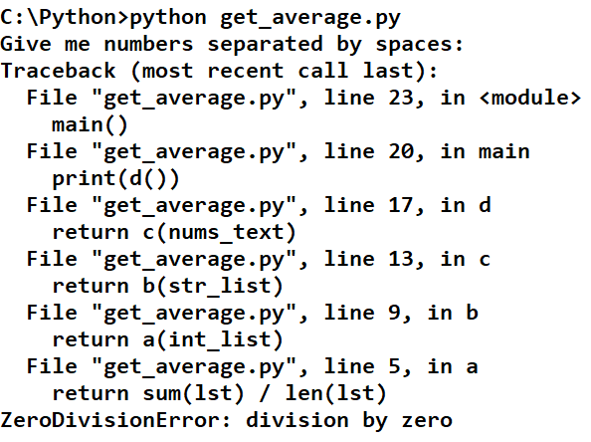

Slide 13
Notes:
Proceed to explain the correlation between the Traceback and the code

Slide 14
Traceback
So, the traceback is:
What called what, up until the error happened?
This helps you find the source of the bug!

Slide 15
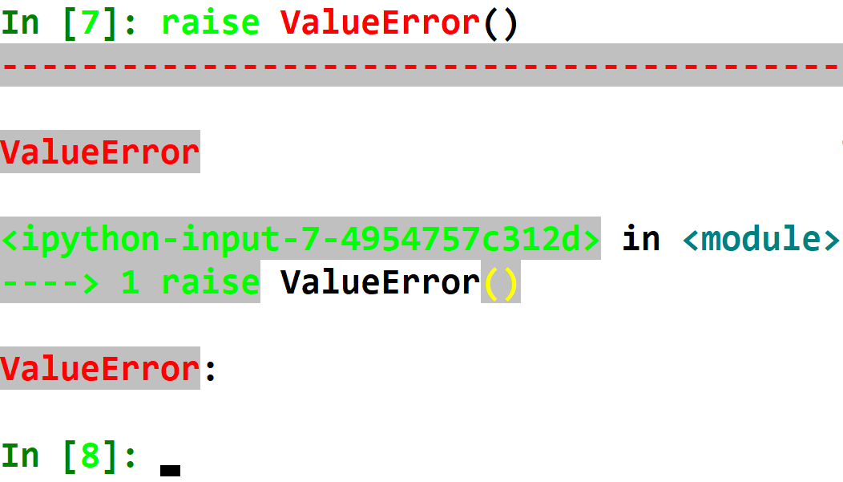
Raising our own Exception
We can raise an exception using the keyword raise.
We then give the type of error we want to raise, followed by brackets.
There is no error message!

Slide 16
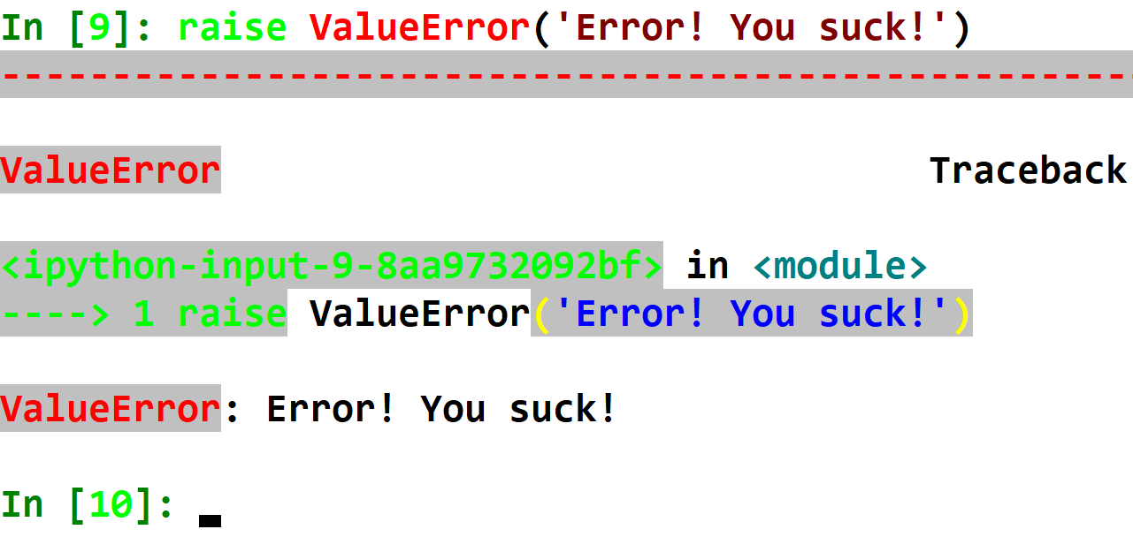
Adding an Error Message
The wanted error message should be given as an input (string).

Slide 17
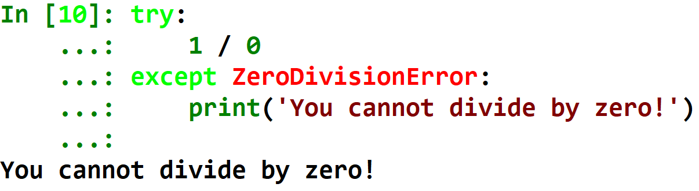
Catching Errors
Errors are caught using the try/except clauses.
Inside try should be the code that can raise an error.
The except should catch the error, and execute a different code.
The error type should be written explicitly!

Slide 18
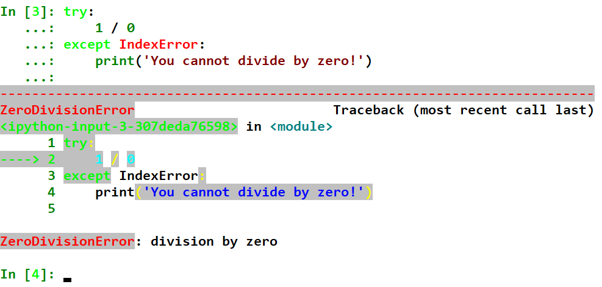
If you don’t catch the right error type, the error is not caught.

Slide 19
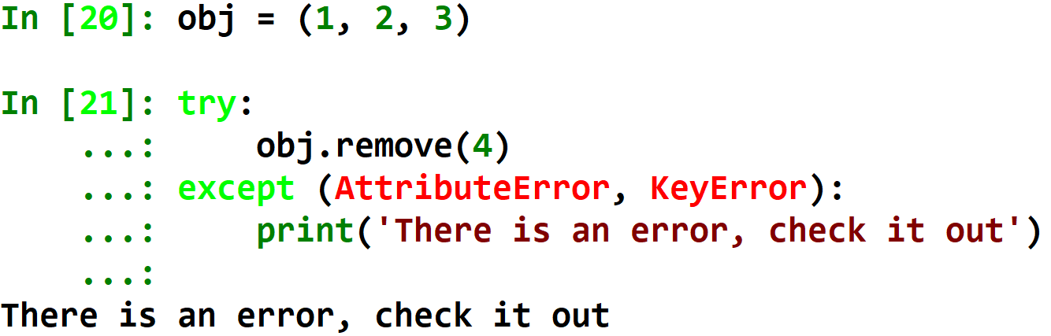
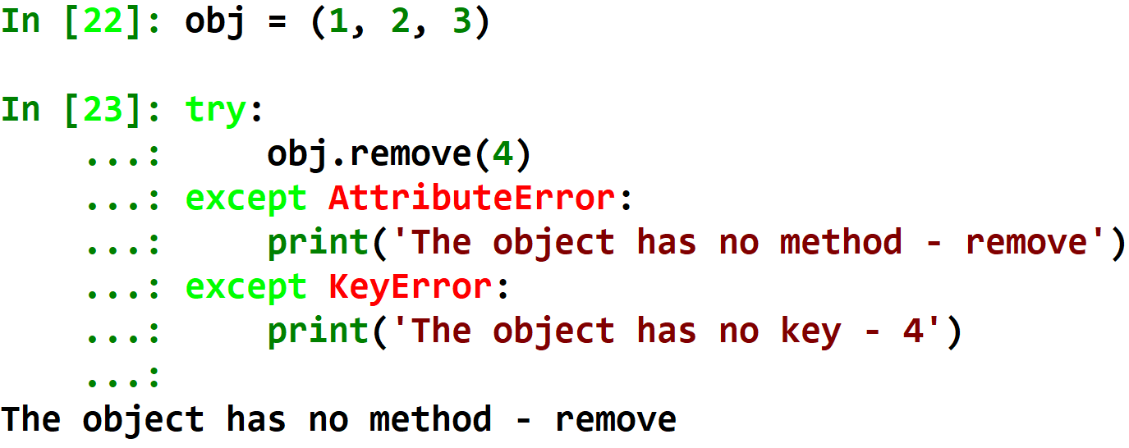
Catching Multiple Error Types
You can catch multiple error types in one except clause, by using a tuple of types:
Or, put multiple except clauses. If an exception is raised, they each will be checked in order.

Slide 20
Remember the Exceptions Hierarchy Tree?

Slide 21
You can use any type of Exception in your except clause, and it will also catch all exception types underneath it in the hierarchy.
For example:
Catching ImportError will catch both ImportError and ModuleNotFoundError.
Catching Exception will catch all Exception types!

Slide 22
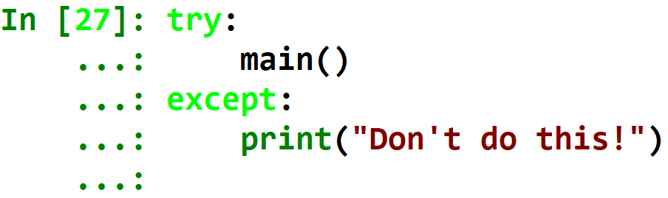
Never, ever – empty except clause
Many inexperienced programmers do this.
This is very bad – this will also catch KeyboardInterrupt, SystemExit, or any crucial Exceptions that you don’t want to catch!
If you want to catch any error type, use except Exception.

Slide 23
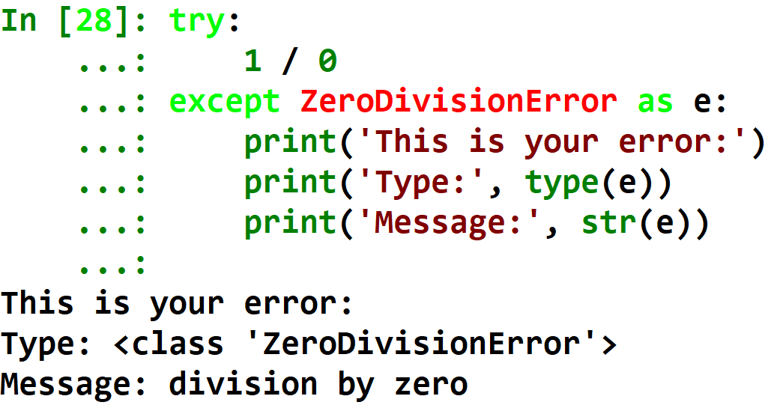
Catching an Exception and Using It
Earlier we learned how to create an exception and raise it.
You can catch and use your exception by using the “as e” syntax.
Your exception’s type can be received by using type(e).
Your exception’s error message can be received by using str(e).

Slide 24
Questions?

